Slide 1
Parallel & Distributed Computing

Slide 2

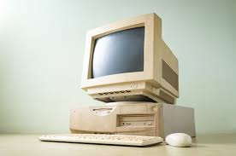

Computing
Computing is any goal-oriented activity requiring, benefiting from, or creating computing machinery. It includes the study and experimentation of algorithmic processes and development of both hardware and software. It has scientific, engineering, mathematical, technological and social aspects.

Slide 3
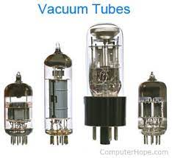
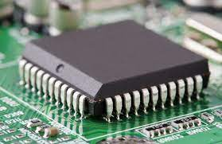
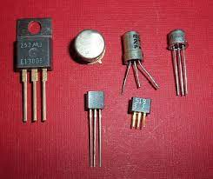

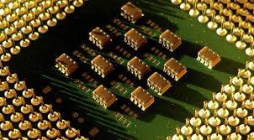
History of Computing
All the Computing generation & Evaluation
· Vacuum Tube
· Transistor
· Integrated Circuits
· Silicon Chips
· AI

Slide 4
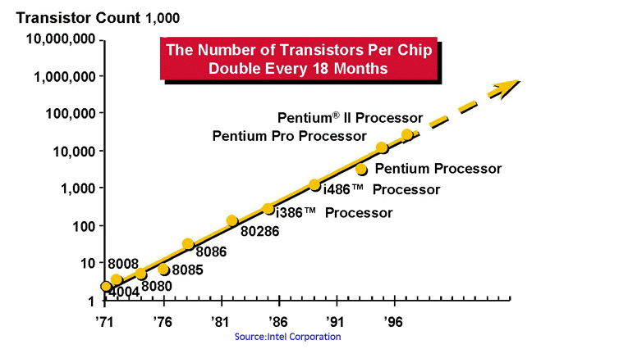
Moore’s Law
Moore's Law refers to Gordon Moore's perception that the number of transistors on a microchip doubles every two years, though the cost of computers is halved. Moore's Law states that we can
expect the speed and capability of our computers to increase every couple of years, and we will pay less for them

Slide 5
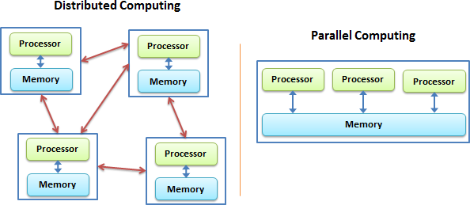
Fundamentals of Parallel & Distributed Computing
While both distributed computing and parallel systems are widely available these days, the main difference between these two is that a parallel computing system consists of multiple processors that communicate with each other using a shared memory, whereas a distributed computing system contains multiple processors connected by a communication network.
Email systems
Cloud file backup/storage systems
Electronic banking
Travel reservation systems
Distributed supercomputers

Slide 6
Distributed Computing | Parallel Computing
Typically consists of a network of computers | Mainly uses several processors
Used to share resources | Used for high performance
Used for consistency and availability | Used for concurrency
Designed to tolerate failures | Designed for massive calculations

Slide 7
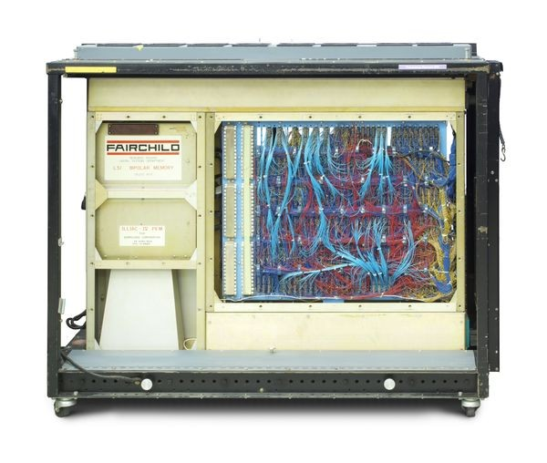
ILLIAC IV
This was the first “massively” parallel computer, built largely at the University of Illinois. The machine was developed in the 1960s with help from NASA and the U.S. Air Force. It had 64 processing elements capable of handling 131,072 bits at a time

Slide 8
Parallel & Serial Computing
A processing in which one task is completed at a time and all the tasks are run by the processor in a sequence. In real time example, people standing in a queue and waiting for a railway ticket. In this case, one person can get a ticket at a time.
In serial processing, same tasks are completed at the same time but in parallel processing completion time may vary.
In sequential processing, the load is high on single core processor and processor heats up quickly.
In serial processing data transfers in bit by bit form while In parallel processing data transfers in byte form i.e. in 8 bits form
Parallel processor is costly as compared to serial processor
Serial processing takes more time than parallel processor

Slide 9
Parallel & Serial Computing
Traditionally, software has been written for serial computation:
A problem is broken into a discrete series of instructions
Instructions are executed sequentially one after another
Executed on a single processor
Only one instruction may execute at any moment in time
In the simplest sense, parallel computing is the simultaneous use of multiple compute resources to solve a computational problem:
A problem is broken into discrete parts that can be solved concurrently
Each part is further broken down to a series of instructions
Instructions from each part execute simultaneously on different processors
An overall control/coordination mechanism is employed

Slide 10
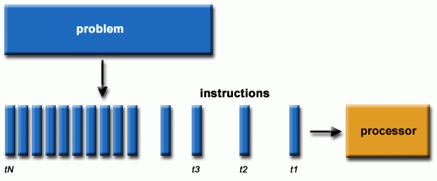
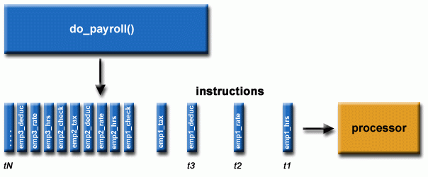
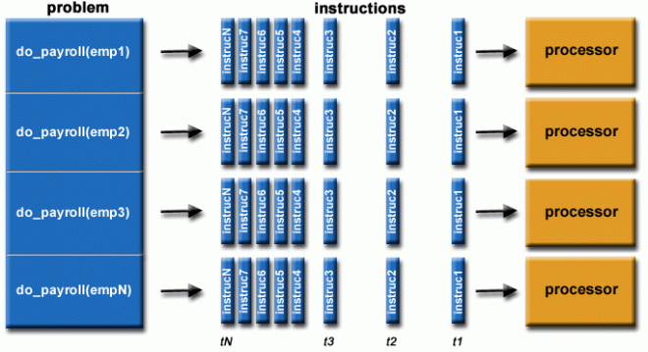
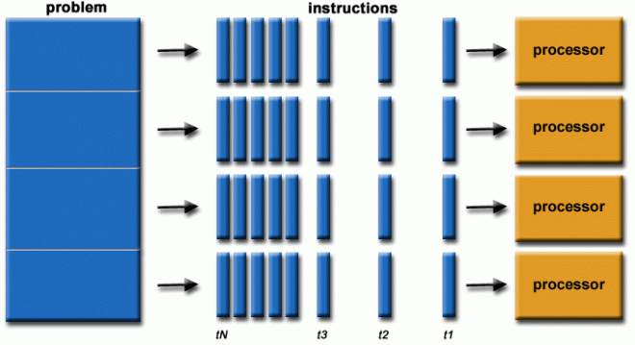

Slide 11
Traditional Computing Types
Traditional computing merely refers to the concept of physical data centers and the dependence of the businesses that use these data centers for the sake of storing their digital assets and running a complete networking system for their day to day operations.
Day to day routine Operations.

Slide 12
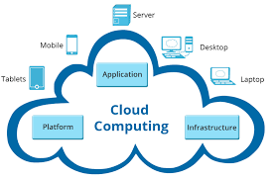
Cloud Computing
Cloud Computing is the combination of configurable components. Moreover, components like system resources and advanced services help deliver tasks using internet connections. Further, it runs tasks on third-party servers and enables the ability to access data from multiple locations. It also provides a cost-efficient solution and is more user-friendly. Above all, it offers more storage space, servers, and computing power to help the apps run efficiently and smoothly. Moreover, it only requires fast, eligible, and stable internet connections to execute tasks.
Examples: File Sharing + Data Storage: Dropbox.

Slide 13
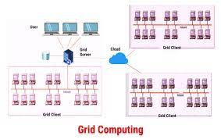
Grid Computing
Grid Computing is a process where computers and devices from various locations work on a single problem. Further, in this system clusters jointly execute given tasks. As a result, it applies resources from multiple computers and nodes. Therefore, it is a type of computing environment that utilizes several and scattered resources. Hence, these resources provide a functioning environment for executing a single task.

Slide 14
Personal Computing
A Personal Computing Environment includes a single machine. Moreover, it incorporates complete programs on a computer and performs it.
For example, machines like laptops, mobiles, printers, etc are a part of the Personal Computing Environment. As a result, this type of computing environment is for single users to run tasks at home or offices.

Slide 15
Time Sharing
A Time-Sharing Computing Environment enables multiple users to share a system concurrently. Furthermore, it allows various time slots for various users and processes. Hence, the processor switches rapidly and changes users according to their slots.
For example, Windows 95 and its later versions, Unix, IOS, Linux OS all run on the time-sharing computing environment

Slide 16
Client Server
Client-Server Computing is a type of environment that incorporates two machines. Therefore, it includes a client machine and a server machine. Sometimes, the same machine serves as the client and the server. Subsequently, a client requests a resource or service and a server provides the same. Moreover, a server provides a resource or service to multiple clients simultaneously. Hence, the communication takes place using a computer network.
Categorization of Client-Server Computing Environment is into two types:
Computer Server: It provides the interface to the clients. Hence, it helps communicate requests to execute tasks.
Meanwhile, the server performs the task and responds with the outcome.
File-Server: The environment provides a file-system interface. Therefore, allowing clients to create, update, read, and delete files.

Slide 17
Peer to Peer
Peer-to-Peer Computing is a type of environment similar to a Distributed type of Computing Environment. That is to say, there are no differences between clients and servers in this type of computing environment.
P2P provides an advantage over traditional client-server environments. That is to say, it provides services using several nodes throughout the network.

Slide 18
Mobile Computing
Mobile Computing refers to the type of environment that runs tasks on smartphones and tablets. Hence, it is computing on portable and lightweight devices.
Although, compared to other devices, mobile systems lack screen size, memory capacity, and other traditional functionalities. However, it does provide remote access to multiple services.
Today, mobile computing environments consist of multiple functions. Hence, it offers services as good as any other traditional device. Moreover, the two main operating systems that dominate this market are Apple iOS and Google Android.

Slide 19
Cluster Computing
In this type of computing environment, clusters execute tasks. Cluster Computing allows clusters to work as a set of loosely or tightly connected computers.
Consequently, it is viewed as a single system and executes tasks parallelly. Hence, it is also similar to a parallel type of computing environment. As a result, the cluster computing environment prefers cluster-aware applications
The clustered computing environment is similar to parallel computing environment as they both have multiple CPUs. However a major difference is that clustered systems are created by two or more individual computer systems merged together which then work parallel to each other.

Slide 20
Pros & Cons of Parallel & Distributed Computing
The advantages of parallel computing are that computers can execute code more efficiently, which can save time and money by sorting through “big data” faster than ever.
Parallel programming can also solve more complex problems, bringing more resources to the table.
Cons: Programming to target Parallel architecture is a bit difficult but with proper understanding and practice, you are good to go.
Extra Cost
Power Consumptions & Better cooling technologies are required in case of clusters.

Slide 21
WEEK-02 LECTURE
PARALLEL AND DISTRIBUTED COMPUTING

Slide 22
· Flynn’s Taxonomy.
Flynn's taxonomy is a classification of computer architectures, proposed by Michael J. Flynn in 1966. and extended in 1972. The classification system has stuck, and it has been used as a tool in design of modern processors and their functionalities.
Flynn's taxonomy is a categorization of forms of parallel computer architectures. From the viewpoint of the assembly language programmer, parallel computers are classified by the concurrency in processing sequences (or streams), data, and instructions.

Slide 23
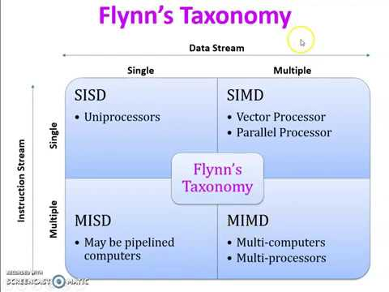

Slide 24
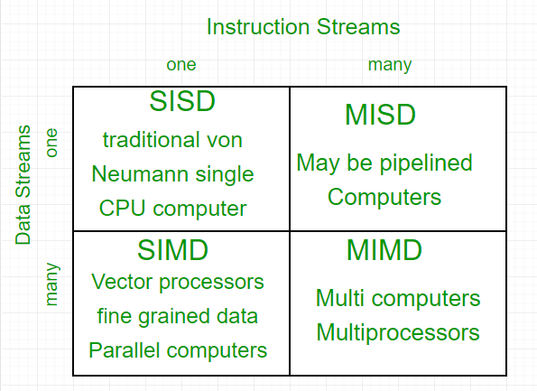

Slide 25
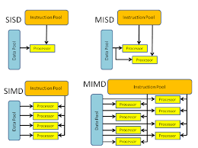

Slide 26
· Introduction to Multithreading
Multithreading is a concept of running multiple threads simultaneously. Thread is a lightweight unit of a process that executes in multithreading environment. A program can be divided into a number of small processes. Each small process can be addressed as a single thread (a lightweight process).
Multithreading is a model of program execution that allows for multiple threads to be created within a process, executing independently but concurrently sharing process resources. Depending on the hardware, threads can run fully parallel if they are distributed to their own CPU core.

Slide 27
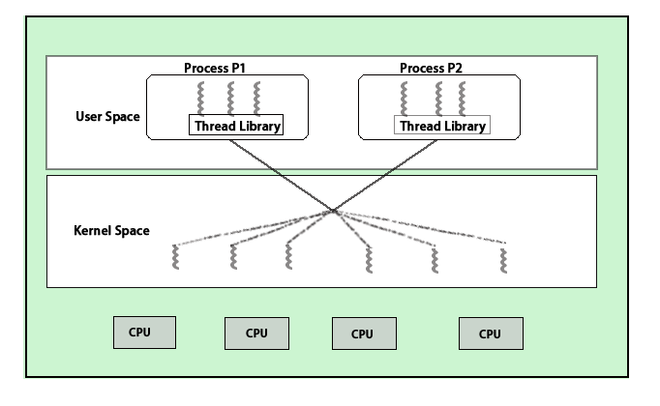

Slide 28
· Parallel algorithms & architectures
Parallel architectures are a sub-class of distributed computing where the processes are all working to solve the same problem. ​There are different kinds of parallelism at various levels of computing.
In computer science, a parallel algorithm, as opposed to a traditional serial algorithm, is an algorithm which can do multiple operations in a given time. It has been a tradition of computer science to describe serial algorithms in abstract machine models, often the one known as random-access machine.
Examples include iterative numerical methods, such as Newton's method, iterative solutions to the three-body problem, and most of the available algorithms to compute pi (π). Some sequential algorithms can be converted into parallel algorithms using automatic parallelization.

Slide 29
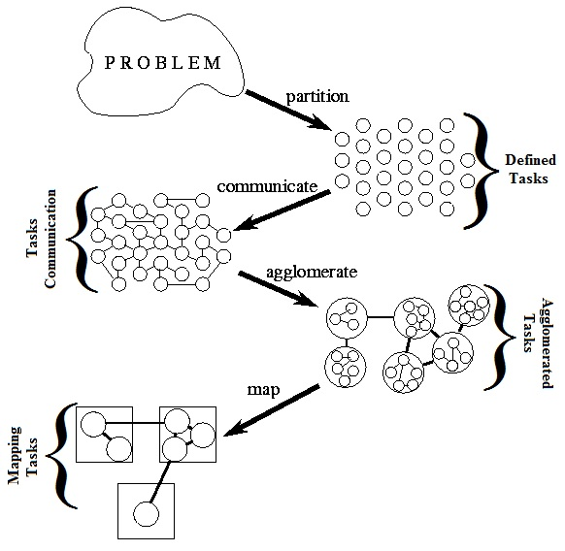

Slide 30

· Parallel I/O
Parallel I/O, in the context of a computer, means the performance of multiple input/output operations at the same time, for instance simultaneously outputs to storage devices and display devices. It is a fundamental feature of operating systems.
Parallel I/O is a subset of parallel computing that performs multiple input/output operations simultaneously. Rather than process I/O requests serially, one at a time, parallel I/O accesses data on disk simultaneously. This allows a system to achieve higher write speeds and maximizes bandwidth.

Slide 31
Parallel Programming models
A parallel programming model is a set of program abstractions for fitting parallel activities from the application to the underlying parallel hardware. It spans over different layers: applications, programming languages, compilers, libraries, network communication, and I/O systems.
There are several different forms of parallel computing: bit-level, instruction-level, data, and task parallelism.
Data Parallelism: Data Parallelism means concurrent execution of the same task on each multiple computing core.
Task Parallelism: Task Parallelism means concurrent execution of the different task on multiple computing cores.
Bit-level parallelism: Bit-level parallelism is a form of parallel computing which is based on increasing processor word size. In this type of parallelism, with increasing the word size reduces the number of instructions the processor must execute in order to perform an operation.
Instruction-level parallelism :means the simultaneous execution of multiple instructions from a program.

Slide 32
· (data-parallel, task-parallel, process-centric, shared/distributed memory)
Process-centric architecture (PCA) is an architecture style that directly addresses this problem by moving the abstraction level further up to the process logic and the process tier.
A distributed shared memory is a mechanism allowing end-users' processes to access shared data without using inter-process communications. In other words, the goal of a DSM system is to make inter-process communications transparent to end-users.

Slide 33
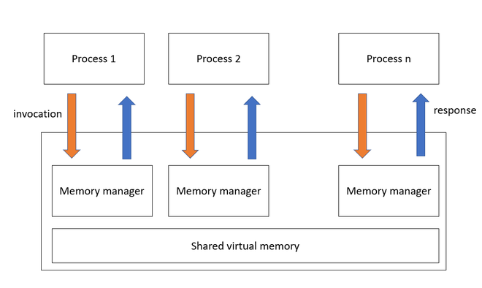

Slide 34
WEEK -03 LECTURE
PARALLEL AND DISTRIBUTED COMPUTING

Slide 35
Asynchronous/synchronous computation/communication,
The key difference between synchronous and asynchronous communication is synchronous communications are scheduled, real-time interactions by phone, video, or in-person. Asynchronous communication happens on your own time and doesn't need scheduling.
Synchronous execution means the first task in a program must finish processing before moving on to executing the next task whereas asynchronous execution means a second task can begin executing in parallel, without waiting for an earlier task to finish.

Slide 36
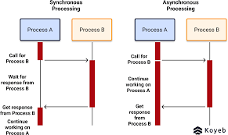

Slide 37
Synchronous | Asynchronous
It sends data in the form of blocks or frames. | Data is sent in the form of character or byte.
Synchronous Transmission is fast. | Asynchronous transmission method is slow.
Synchronous Transmission is costly. | Asynchronous Transmission is economical.

Slide 38
· Concurrency control
If many transactions try to access the same data, then inconsistency arises. Concurrency control required to maintain consistency data. For example, if we take ATM machines and do not use concurrency, multiple persons cannot draw money at a time in different places. This is where we need concurrency.
The property or an instance of being concurrent; something that happens at the same time as something else. a property of systems where several processes execute at the same time.

Slide 39
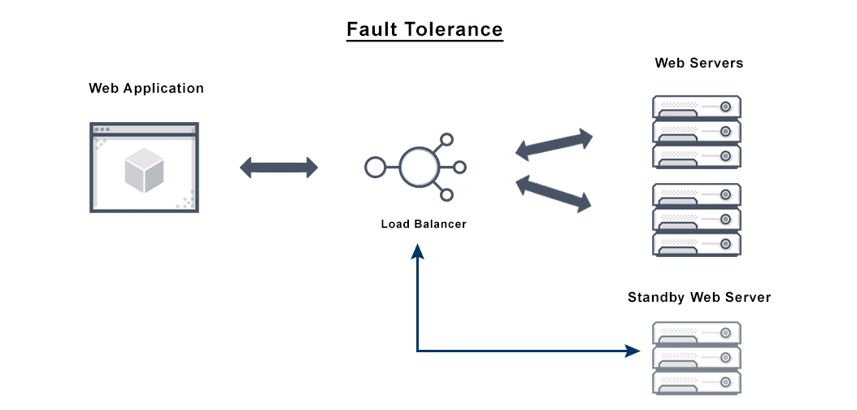
· Fault tolerance
Fault Tolerance simply means a system's ability to continue operating uninterrupted despite the failure of one or more of its components. This is true whether it is a computer system, a cloud cluster, a network, or something else.

Slide 40
· Case Studies: From problem specification to a parallelized solution
Assignment

Slide 41
WEEK-04 LECTURE
PARALLEL AND DISTRIBUTED COMPUTING

Slide 42
· GPU architecture and programming,
The main difference between CPU and GPU architecture is that a CPU is designed to handle a wide-range of tasks quickly (as measured by CPU clock speed), but are limited in the concurrency of tasks that can be running. A GPU is designed to quickly render high-resolution images and video concurrently.
GPUs use common CPU concepts. The simplest GPU model is essentially a CPU with lots of cores, meaning that you will again encounter concepts like ALUs (as they use lots of them), L1 and L2 caches, instructions and data, pipelined CPU designs, and threads.

Slide 43
· Heterogeneity
Heterogeneity: The Internet enables users to access services and run applications over a heterogeneous collection of computers and networks.
Transparency:
Openness.
Concurrency.
Security.
Scalability.
Failure Handling.
A heterogeneous computing system refers to a system that contains different types of computational units, such as multicore CPUs, GPUs,

Slide 44
Introduction to OpenCL
Open Computing Language
OpenCL (Open Computing Language) is a framework for writing programs that execute across heterogeneous platforms consisting of central processing units (CPUs), graphics processing units (GPUs), digital signal processors (DSPs), field-programmable gate arrays (FPGAs) and other processors or hardware accelerators.
OpenCL is the dominant open general-purpose GPU computing language, and is an open standard defined by the Khronos Group. OpenCL provides a cross-platform GPGPU platform that additionally supports data parallel compute on CPUs.
OpenCL makes it possible to write and deploy applications that use multiple types of devices for processing. They include not just GPUs, but also CPUs (which, again, can be used effectively in conjunction with OpenCL in certain scenarios), Digital Signal Processors (DSPs) and other types of hardware accelerators.

Slide 45
Message passing interface (MPI)
Message Passing Interface (MPI) is a standardized and portable message-passing system developed for distributed and parallel computing. MPI provides parallel hardware vendors with a clearly defined base set of routines that can be efficiently implemented.
Message Passing Interface (MPI) is a system that aims to provide a portable and efficient standard for message passing. It is widely used for message passing programs, as it defines useful syntax for routines and libraries in different computer programming languages such as Fortran, C, C++ and Java.
This is a two-sided operation: the sending process describes the data to be sent and the receiving process describes how to receive the message.

Slide 46
WEEK -05 LECTURE
PARALLEL AND DISTRIBUTED COMPUTING

Slide 47
Full Virtualization vs Partial Virtualization
In Full virtualization, virtual machine permit the execution of the instructions with running of unmodified OS in an entire isolated way. In paravirtualization, virtual machine does not implement full isolation of OS but rather provides a different API which is utilized when OS is subjected to alteration
In Partial virtualization multiple instances of an underlying hardware environment are simulated. It is not mandatory that in para virtualization, it simulates hardware. It may provide an API, which can be exceptionally used by altering the guest operating systems.
Full virtualization is a virtualization technique used to provide a VME that completely simulates the underlying hardware. In this type of environment, any software capable of execution on the physical hardware can be run in the VM, and any OS supported by the underlying hardware can be run in each individual VM.

